Slide 1
Program
MineOperate Technical Level 1
Working with Map Projections
Edgar Sepulveda
Global Technical Manager, MineOperate
Date 10/10/2022
Version 1.3

Slide 2

Purpose
This session shows how OP Pro maps use a map projection and how this map projection is created.
At the end of this module, you will:
understand how OP Pro saves GPS coordinates in its database.
know that OP Pro maps use a map projection to show local coordinates in:
Mine Map
Playback
Drill & Blast
JSPanel Map
know how to create an OP Pro map projection.

Slide 3
Why Do We Need Map Projections?
The Global Positioning System (GPS) uses the World Geodetic System (WGS84) as its reference coordinate system and its coordinates are presented as
Latitude
Longitude
Elevation
OP Pro uses local coordinate system so a map projection is used to flatten out a part of earth and show it in a map, the local coordinate system presents coordinates as
Northing
Easting
Elevation

Slide 4
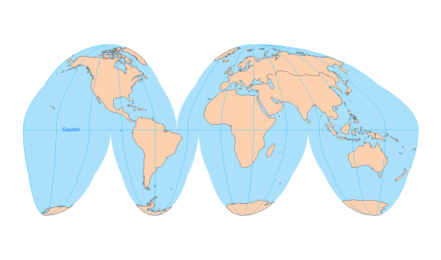

OP Pro Maps
OP Pro maps are two dimensions representations of earth, so a map projection is used to flatten out a part of earth and show it in a map.

Slide 5

How OP Pro Saves GPS Coordinates
Global Positioning System (GPS) coordinates.
- Latitude
- Longitude
- Elevation
OP Pro saves WGS84 coordinates, latitude and longitude, times 3’600,000
 | Coordinate | Latitude | Longitude
GPS receiver | WGS84 | 39.9336978 | -115.4791528
OP Pro database | WGS84 x 3600000 | 143761312 | -415724950

Slide 6
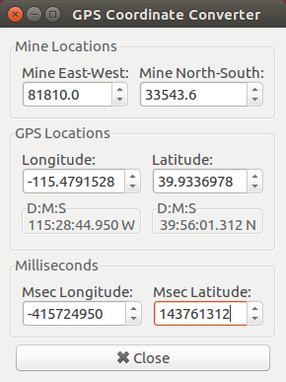
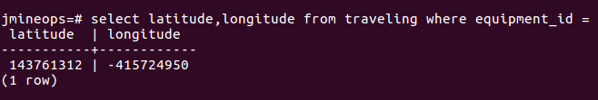
OP Pro GPS Conversion Tool
 | Latitude | Longitude
GPS receiver | 39.9336978 | -115.4791528
OP Pro database | 143761312 | -415724950

Slide 7
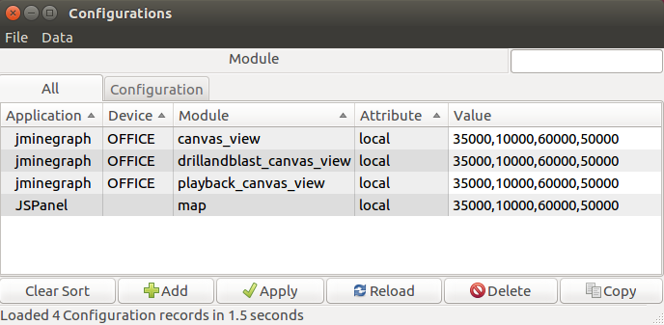
OP Pro Maps
Mine map, Playback, Drill & Blast and JSPanel Map use local coordinates to show locations in their maps.
Northing
Easting
Elevation

Slide 8
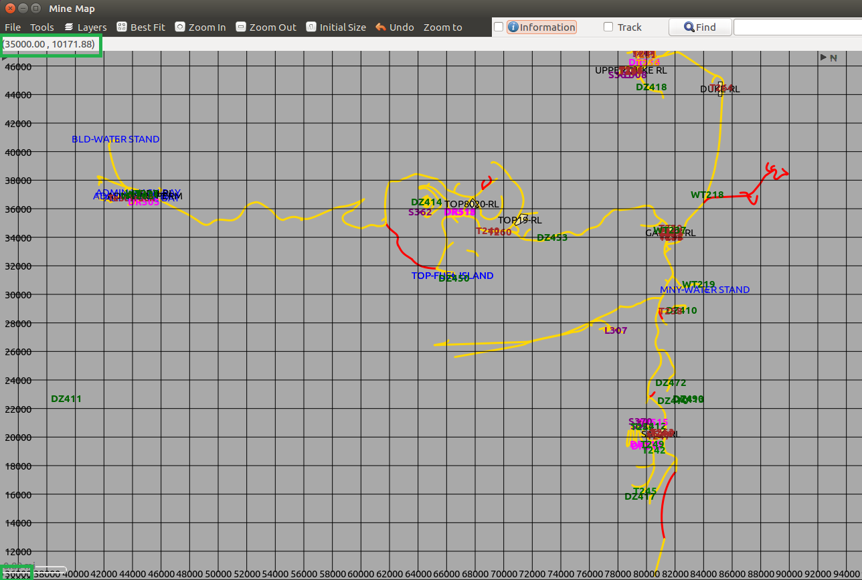
OP Pro Mine Map

Slide 9
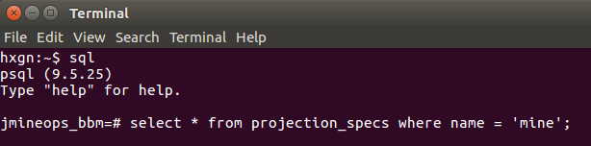
OP Pro Map projection

Slide 10
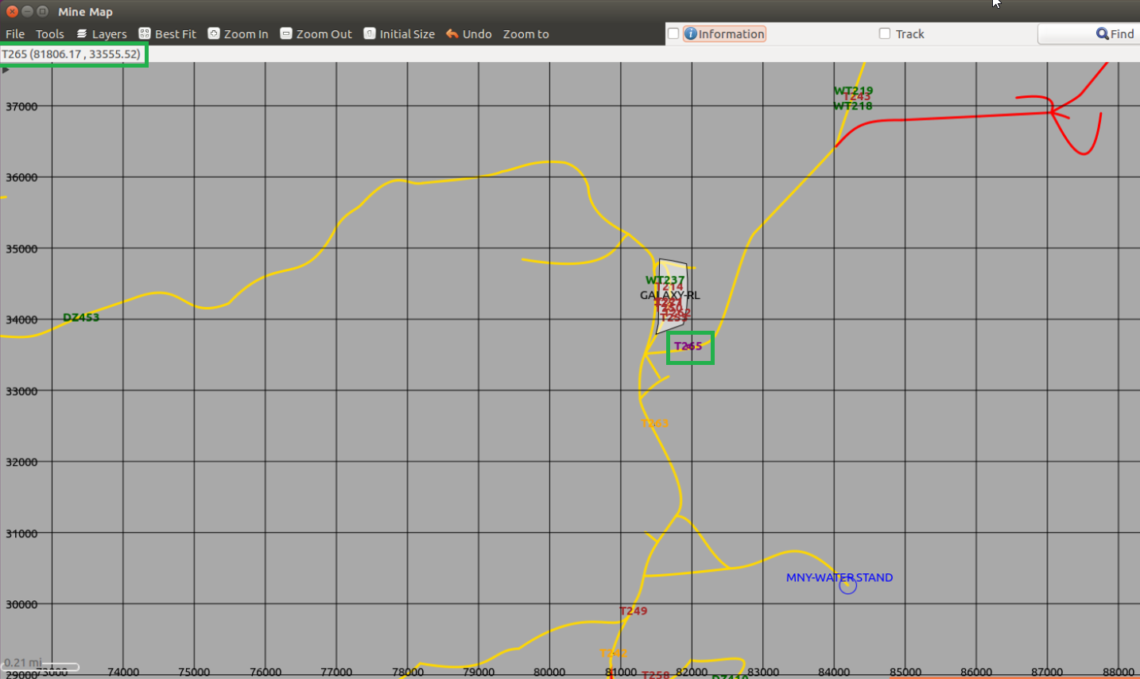
OP Pro Mine Map

Slide 11
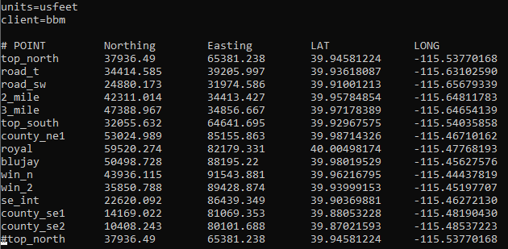
How to Create an OP Pro Map Projection

Slide 12
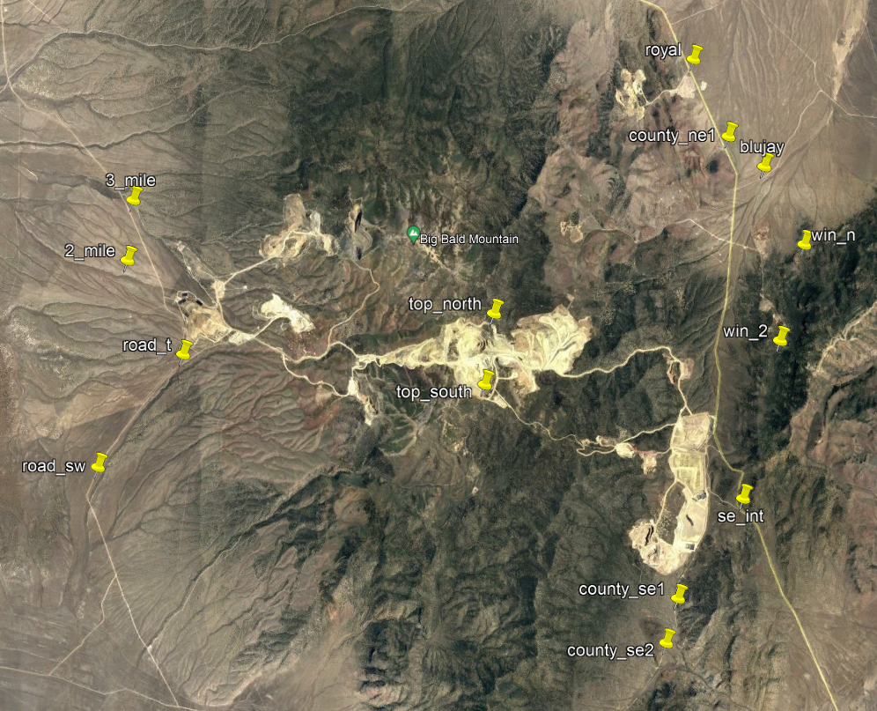
How to create an OP Pro map projection

Slide 13
How to Create an OP Pro Map Projection
Copy txt file to /opt/Jigsaw/Clients/client/ folder
Change directory to /opt/Jigsaw/Library/jmineops/lib/ folder
Execute compute_projection.rb script adding file path and name
./compute_projection.rb /opt/Jigsaw/Clients/client/OP_Pro_projection_points.txt
Check script messages
Check MineCoordinate.proj file
Load specification string to projection_specs table where name is equal to mine
Restart JAMS

Slide 14
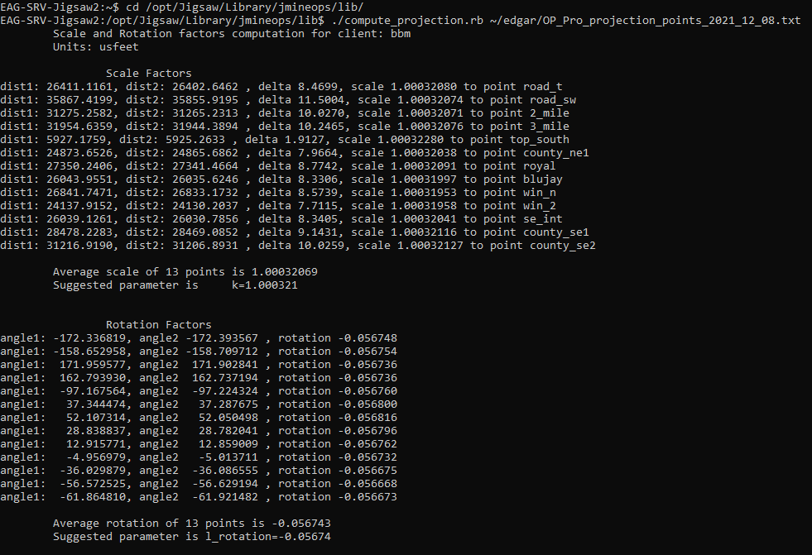
How to Create an OP Pro Map Projection

Slide 15
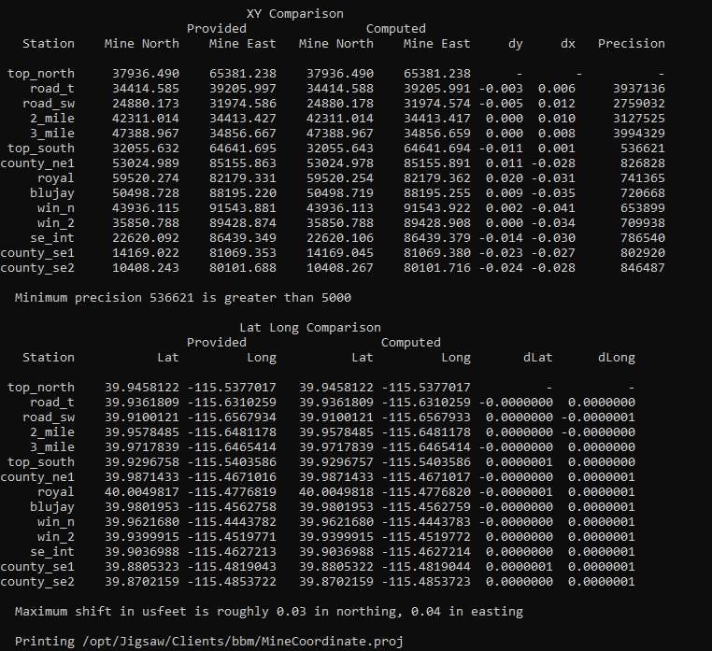
How to Create an OP Pro Map Projection

Slide 16
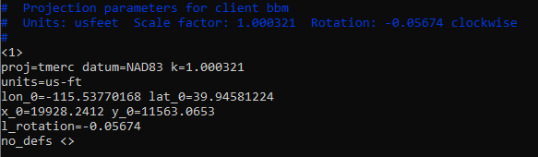
How to Create an OP Pro Map Projection

Slide 17
References
Geography
https://gisgeography.com/wgs84-world-geodetic-system/
Earth Point
https://www.earthpoint.us/convert.aspx
Confluence Hexagon Mining Division
How to create a projection
https://confluence.hexagonmining.com/pages/viewpage.action?pageId=160769103
Bursawolf Transformations
https://confluence.hexagonmining.com/display/PE/How+To+Generate+Bursawolf+Transformations

Slide 18
Working With Map Projections - Questions
True or False The Global Positioning System (GPS) presents its coordinates as Northing, Easting and Elevation.
True or False A map projection is used to flatten out a part of earth and show it in a map.
What OP Pro Manager applications use a map projection?
Mine Map
MTC
Playback
Drill & Blast
All above
True or False OP Pro Map Projection uses the record with column name equals to 'mine' from projection_specs table.
What is the file name that compute_projection.rb ruby script creates if txt data file passes all checks? ______________ .

Slide 19
Working With Map Projections - Answers to Questions
True or False The Global Positioning System (GPS) presents its coordinates as Northing, Easting and Elevation. False
True or False A map projection is used to flatten out a part of earth and show it in a map. True
What OP Pro Manager applications use a map projection?
Mine Map
MTC
Playback
Drill & Blast
All above
True or False OP Pro Map Projection uses the record with column name equals to 'mine' from projection_specs table. True
What is the file name that compute_projection.rb ruby script creates if txt data file passes all checks? MineCoordinate.proj

Slide 20

THANK
Y
O
U

